Slide 1
Chapter 6 Estimates
6.1. Estimating a Population Proportion
6.2. Estimating a Population Mean
6.3. Estimating a Population Standard Deviation or Variance

Slide 2
Review
In Chapters 2, we used descriptive statistics when we summarized data using tools such as graphs and statistics such as the mean and standard deviation.
Chapter 6 we introduced critical values:
z_{α} denotes the z score with an area of α to its right. If α = 0.025, the critical value is z_{0.025} = 1.96.
That is, the critical value z_{0.025} = 1.96 has an area of 0.025 to its right.

Slide 3
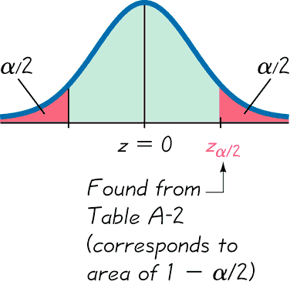
Critical value

Slide 4
Preview
This chapter presents the beginning of inferential statistics.
The two major activities of inferential statistics are (1) to use sample data to estimate values of a population parameters, and (2) to test hypotheses or claims made about population parameters.
We introduce methods for estimating values of these important population parameters: proportions, means, and standard deviation / variances.
We also present methods for determining sample sizes necessary to estimate those parameters.

Slide 5
6.1. Estimating a Population Proportion
In this section we present methods for using a sample proportion (tỷ lệ mẫu) to estimate the value of a population proportion (tỷ lệ của quần thể).
The sample proportion is the best point estimate (ước lượng điểm) of the population proportion.
We can use a sample proportion to construct a confidence interval (khoảng tin cậy) to estimate the true value of a population proportion, and we should know how to interpret such confidence intervals.
We should know how to find the sample size (kích thước mẫu) necessary to estimate a population proportion.

Slide 6
Definition
A point estimate is a single value (or point) used to approximate a population parameter.

Slide 7
Definition
The sample proportion is the best point estimate of the population proportion p.

Slide 8
Example
The Pew Research Center conducted a survey of 1007 adults and found that 85% of them know what Twitter is.
The best point estimate of p, the population proportion, is the sample proportion:

Slide 9
Definition
A confidence interval (or interval estimate) is a range (or an interval) of values used to estimate the true value of a population parameter.
A confidence interval is sometimes abbreviated as CI.

Slide 10
Definition
A confidence level (độ tin cậy) is the probability 1 – α (often expressed as the equivalent percentage value) that the confidence interval actually does contain the population parameter, assuming that the estimation process is repeated a large number of times. (The confidence level is also called degree of confidence, or the confidence coefficient.)
Most common choices are 90%, 95%, or 99%.
(α = 0.10), (α = 0.05), (α = 0.01)

Slide 11
Interpreting a Confidence Interval
We must be careful to interpret confidence intervals correctly. There is a correct interpretation and many different and creative incorrect interpretations of the confidence interval 0.828 < p < 0.872.
“We are 95% confident that the interval from 0.828 to 0.872 actually does contain the true value of the population proportion p.”
This means that if we were to select many different samples of size 1007 and construct the corresponding confidence intervals, 95% of them would actually contain the value of the population proportion p.
(Note that in this correct interpretation, the level of 95% refers to the success rate of the process being used to estimate the proportion.)

Slide 12
Caution
Know the correct interpretation of a confidence interval.
Confidence intervals can be used informally to compare different data sets, but the overlapping of confidence intervals should not be used for making formal and final conclusions about equality of proportions.

Slide 13
Using Confidence Intervals for Hypothesis Tests
A confidence interval can be used to test some claim made about a population proportion p.
For now, we do not yet use a formal method of hypothesis testing, so we simply generate a confidence interval and make an informal judgment based on the result.

Slide 14
Critical Values
A standard z score can be used to distinguish between sample statistics that are likely to occur and those that are unlikely to occur. Such a z score is called a critical value. Critical values are based on the following observations:
Under certain conditions, the sampling distribution of sample proportions can be approximated by a normal distribution.
A z score associated with a sample proportion has a probability of α/2 of falling in the right tail.

Slide 15
Critical Values
3. The z score separating the right-tail region is commonly denoted by z_{α/2} and is referred to as a critical value because it is on the borderline separating z scores from sample proportions that are likely to occur from those that are unlikely to occur.

Slide 16
Definition
A critical value is the number on the borderline separating sample statistics that are likely to occur from those that are unlikely to occur.
The number z_{α/2} is a critical value that is a z score with the property that it separates an area of α/2 in the right tail of the standard normal distribution.

Slide 17
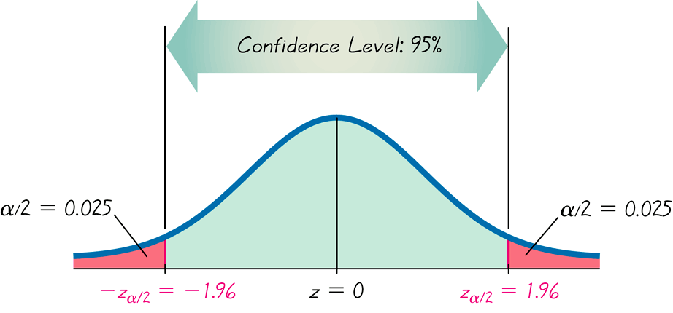
Finding z_{α/2} for a 95% Confidence Level
Critical Values

Slide 18
Common Critical Values
Confidence Level | α | Critical Value, z_{α/2}
90% | 0.10 | 1.645
95% | 0.05 | 1.96
99% | 0.01 | 2.575

Slide 19
Definition
When data from a simple random sample are used to estimate a population proportion p, the margin of error, denoted by E, is the maximum likely difference (with probability 1 – α, such as 0.95) between the observed proportion and the true value of the population proportion p.

Slide 20
Margin of Error for Proportions
The margin of error E is also called the maximum error of the estimate and can be found by multiplying the critical value and the standard deviation of the sample proportions:

Slide 21
Confidence Interval for Estimating a Population Proportion p
p = population proportion
= sample proportion
n = number of sample values
E = margin of error
z_{α/2} = z score separating an area of α/2 in the right tail of the standard normal distribution.

Slide 22
Confidence Interval for Estimating a Population Proportion p
1. The sample is a simple random sample.
2. The conditions for the binomial distribution are satisfied: there is a fixed number of trials, the trials are independent, there are two categories of outcomes, and the probabilities remain constant for each trial.
3. There are at least 5 successes and 5 failures.

Slide 23
Confidence Interval for Estimating a Population Proportion p
where

Slide 24
Round-Off Rule for Confidence Interval Estimates of p
Round the confidence interval limits for p to three significant digits.

Slide 25
Procedure for Constructing a Confidence Interval for p
1. Verify that the required assumptions are satisfied. (The sample is a simple random sample, the conditions for the binomial distribution are satisfied, and the normal distribution can be used to approximate the distribution of sample proportions because np ≥ 5, and nq ≥ 5 are both satisfied.)
2. Refer to Table A-2 and find the critical value z_{α/2} that corresponds to the desired confidence level.
3. Evaluate the margin of error

Slide 26
Procedure for Constructing a Confidence Interval for p - cont
4. Using the value of the calculated margin of error E and the value of the sample proportion, , find the values of and . Substitute those values in the general format for the confidence interval:
5. Round the resulting confidence interval limits to three significant digits.

Slide 27
Example
In the Chapter Problem we noted that a Pew Research Center poll of 1007 randomly selected adults showed that 85% of respondents know what Twitter is. The sample results are n = 1007 and
a. Find the margin of error E that corresponds to a 95% confidence level.
b. Find the 95% confidence interval estimate of the population proportion p.
c. Based on the results, can we safely conclude that more than 75% of adults know what Twitter is?
d. Assuming that you are a newspaper reporter, write a brief statement that accurately describes the results and includes all of the relevant information.

Slide 28
Example - Continued
Requirement check: simple random sample; fixed number of trials, 1007; trials are independent; two outcomes per trial; probability remains constant. Note: number of successes and failures are both at least 5.
a) Use the formula to find the margin of error.

Slide 29
Example - Continued
b) The 95% confidence interval:

Slide 30
Example - Continued
Based on the confidence interval obtained in part (b), it does appear that more than 75% of adults know what Twitter is.
Because the limits of 0.828 and 0.872 are likely to contain the true population proportion, it appears that the population proportion is a value greater than 0.75.

Slide 31
Example - Continued
Here is one statement that summarizes the results:
85% of U.S. adults know what Twitter is. That percentage is based on a Pew Research Center poll of 1007 randomly selected adults.
In theory, in 95% of such polls, the percentage should differ by no more than 2.2 percentage points in either direction from the percentage that would be found by interviewing all adults in the United States.

Slide 32
Analyzing Polls
When analyzing polls consider:
1. The sample should be a simple random sample, not an inappropriate sample (such as a voluntary response sample).
2. The confidence level should be provided. (It is often 95%, but media reports often neglect to identify it.)
3. The sample size should be provided. (It is usually provided by the media, but not always.)
4. Except for relatively rare cases, the quality of the poll results depends on the sampling method and the size of the sample, but the size of the population is usually not a factor.

Slide 33
Caution
Never follow the common misconception that poll results are unreliable if the sample size is a small percentage of the population size.
The population size is usually not a factor in determining the reliability of a poll.

Slide 34
Sample Size
Suppose we want to collect sample data in order to estimate some population proportion.
The question is how many sample items must be obtained?

Slide 35
Determining Sample Size
(solve for n by algebra)

Slide 36
Sample Size for Estimating Proportion p
When an estimate of is known:
When no estimate of is known:
(Cauchy inequality: x(1-x)<=1/4)

Slide 37
Round-Off Rule for Determining Sample Size
If the computed sample size n is not a whole number, round the value of n up to the next larger whole number.

Slide 38
Example
Many companies are interested in knowing the percentage of adults who buy clothing online.
How many adults must be surveyed in order to be 95% confident that the sample percentage is in error by no more than three percentage points?
a. Use a recent result from the Census Bureau: 66% of adults buy clothing online.
b. Assume that we have no prior information suggesting a possible value of the proportion.

Slide 39
Example - Continued
a) Use
To be 95% confident that our sample percentage is within three percentage points of the true percentage for all adults, we should obtain a simple random sample of 958 adults.

Slide 40
Example - Continued
b) Use
To be 95% confident that our sample percentage is within three percentage points of the true percentage for all adults, we should obtain a simple random sample of 1068 adults.

Slide 41
Finding the Point Estimate and E from a Confidence Interval
Point estimate of :
= (upper confidence limit) + (lower confidence limit)
2
Margin of Error:
= (upper confidence limit) — (lower confidence limit)
2

Slide 42
6.2. Estimating a Population Mean
1. We should know that the sample mean is the best point estimate of the population mean μ.
2. We should learn how to use sample data to construct a confidence interval for estimating the value of a population mean, and we should know how to interpret such confidence intervals.
3. We should develop the ability to determine the sample size necessary to estimate a population mean.

Slide 43
Requirements
The procedure we use has a requirement that the population is normally distributed or the sample size is greater than 30.

Slide 44
Confidence Interval for Estimating a Population Mean (with σ Known)
μ = population mean
= sample mean
σ = population standard deviation
n = number of sample values
E = margin of error
z _{α/2} = critical z value separating an area of α/2 in the right tail of the standard normal distribution
Notes:
Smaller samples will have means that are likely to vary more. The greater variation is accounted for by the t distribution.
Students usually like hearing about the history of how the Student t distribution got its name.
page 350 of text
See Note to Instructor in margin for other ideas.

Slide 45
Confidence Interval for Estimating a Population Mean (with σ Known)
1. The sample is a simple random sample. (All samples of the same size have an equal chance of being selected.)
2. The value of the population standard deviation σ is known.
3. Either or both of these conditions is satisfied: The population is normally distributed or n > 30.
Notes:
page 338 of Elementary Statistics, 10th Edition

Slide 46
Margin of Error E for Estimate of μ (With σ Not Known)
where has n – 1 degrees of freedom
of Student t Distribution (or shorter, t Distribution).
Table A-3 lists values for .

Slide 47
Confidence Interval for the Estimate of μ (With σ Not Known)

Slide 48
Ví dụ:
1. Trong một cuộc khảo sát 64 khách hàng ở một tiệm ăn nhanh, thời gian đợi trung bình là 3 phút và độ lệch tiêu chuẩn là 1,5 phút. Tìm khoảng tin cậy 99% cho thời gian đợi phục vụ trung bình của tiệm ăn trên. (Nhóm 1, 4, 7, 10, 13)
2. Người ta muốn tìm khoảng tin cậy 95% cho điểm thi tốt nghiệp THPT Quốc gia với độ chính xác 0,2. Một mẫu điều tra sơ bộ với độ lệch chuẩn là 1,2 điểm. Tìm kích thước mẫu n. (Nhóm 2, 5, 8, 11, 14)
3. Chọn mẫu ngẫu nhiên gồm 200 sinh viên của Trường A thì có 74 sinh viên không ở nội trú. Tìm khoảng tin cậy 90% cho tỷ lệ sinh viên không ở nội trú của Trường A. (Nhóm 3, 6, 9,12)

Slide 50
Choosing the Appropriate Distribution
Use the normal (z) distribution
σ known and
normally distributed population or n > 30
Use t distribution
σ not known and
normally distributed population or n > 30
Use a nonparametric method or bootstrapping
Population is not normally distributed and n ≤ 30

Slide 51
Bài tập:
1. Khi gọi điện thoại một khách hàng quên mất số cuối cùng mà chỉ nhớ là hai số đó khác nhau nên đã quyết định chọn ngẫu nhiên hai số (chỉ thực hiện 1 lần). Tính xác suất người đó chọn được đúng số cần gọi.
2. Một chùm chìa khoá có 5 chìa trong đó có 1 chìa mở được ổ khoá. Một người mở ổ khoá bằng cách thử ngẫu nhiên từng chìa cho đến khi mở được ổ khoá (loại bỏ chìa không mở được ra khỏi chùm). Tính xác suất người đó mở được ổ khoá ở lần thử thứ 2.

Slide 52
Bài tập:
3. Một kho hàng chứa các sản phẩm do 2 nhà máy sản xuất, trong đó số sản phẩm của nhà máy I gấp đôi số sản phẩm của nhà máy II. Tỷ lệ sản phẩm bị hỏng của nhà máy I là 0,02, của nhà máy II là 0,03. Lấy ngẫu nhiên 01 sản phẩm.
a) Tính xác suất sản phẩm đó là sản phẩm tốt.
b) Giả sử sản phẩm được lấy ra là sản phẩm bị hỏng. Tính xác suất sản phẩm đó là do nhà máy I sản suất.

Slide 53
Bài tập:
4. Khảo sát thời gian sử dụng điện thoại của sinh viên trường A bằng cách chọn ngẫu nhiên 150 sinh viên. Ta thu được thời gian sử dụng trung bình trong một ngày là 4,5 giờ với độ lệch chuẩn là 0,6 giờ và có 45 sinh viên sử dụng điện thoại nhiều hơn 5 giờ mỗi ngày.
a) Hãy tìm khoảng tin cậy 95% cho thời gian sử dụng điện thoại trung bình mỗi ngày của sinh viên Trường A.
b) Những sinh viên sử dụng điện thoại nhiều hơn 5 giờ mỗi ngày là sử dụng ở mức cao. Hãy ước lượng tỷ lệ sinh viên sử dụng điện thoại ở mức cao của sinh viên Trường A với độ tin cậy 90%
c) Muốn tìm khoảng tin cậy 99% cho tỷ lệ sinh viên sử dụng điện thoại ở mức cao thì kích thước mẫu tối thiểu là bao nhiêu?

